Slide 1
Corey Oil, LTD.
Baskar Dakshinamoorthy
Thomas Freitas
Yen Yung Geszvain
Guillermo Gonzalez
IST 687 Final
Summer 2018

Slide 2
Project Summary, Questions, Goal
Corey Oil, LTD, 40 years in service, Oil distributor in WI
Access to 2018 invoice database
Why is database valuable and important?
Can the raw data be analyzed?
What recommendations can be made?
How will it impact the business?
Goal - To turn the data into valuable proposals and suggestions via descriptive analytics, predictive analytics, and quantitative analytics.
TF

Slide 3
Data Gathering, Processing, Grouping
Began with CSV file
Contained 28,000 rows, and 32 attributes
Data processing eliminated N/A and null rows
Data processing eliminated useless attributes
Working file had 15,000 rows and 17 usable attributes of data
TF

Slide 4
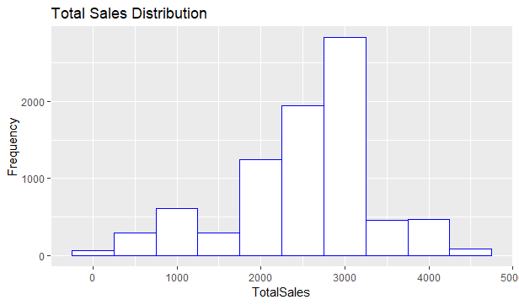
Total Sales Distribution
Chart shows distribution of total sales
Most sales between 2000-3000
Distribution is fairly normal
TF

Slide 5
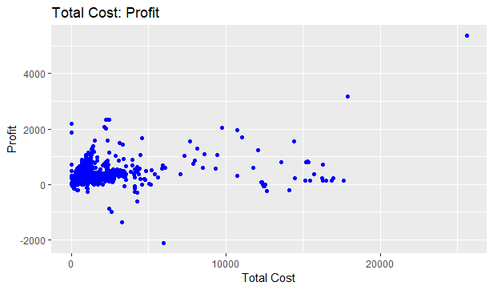
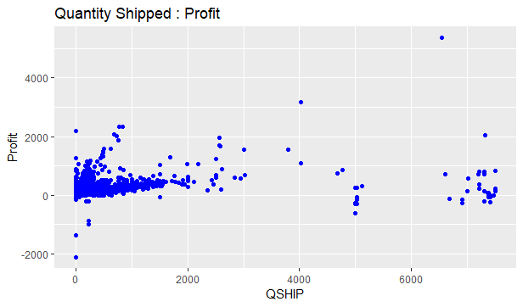
Scatter Plots
Scatter plots show Total cost vs Profit, and quantity shipped vs profit
Higher costs to company does not seem to mean higher profit
Quantity shipped does not seem to mean high profit
TF

Slide 6
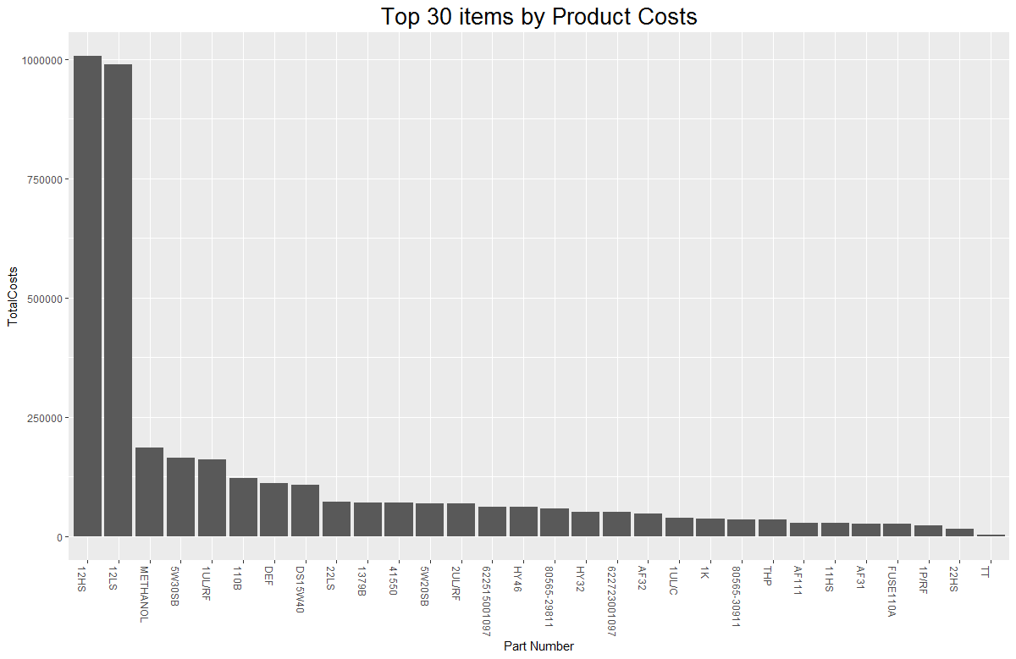
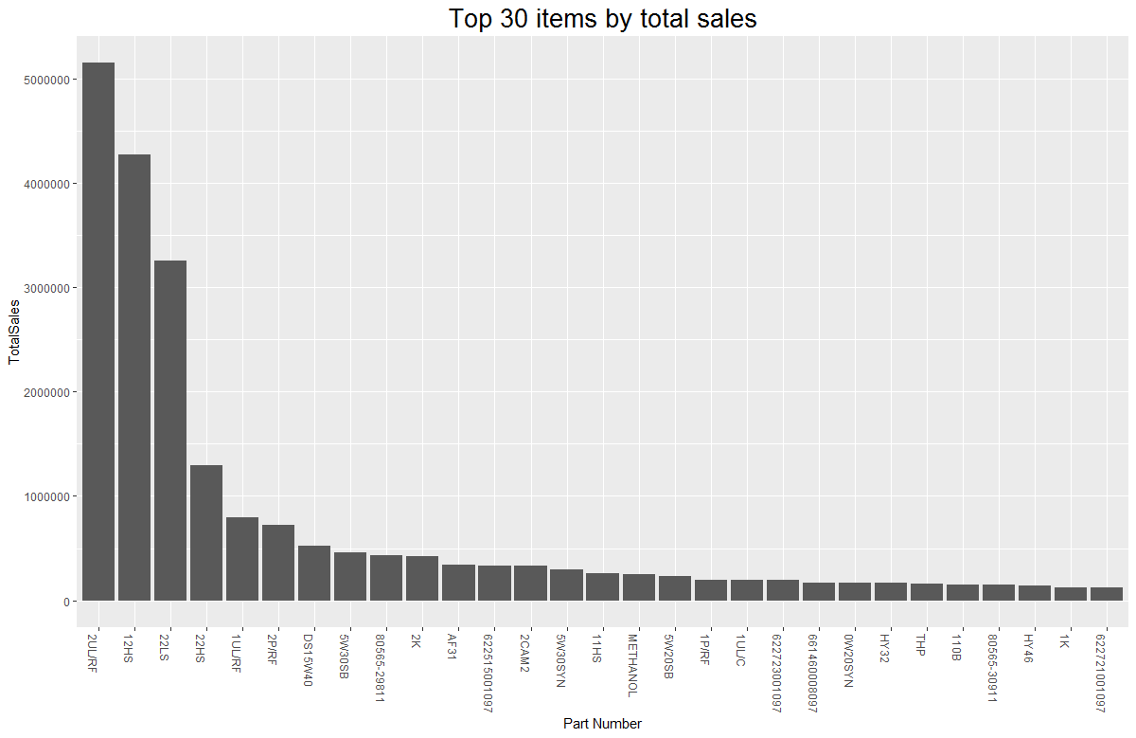
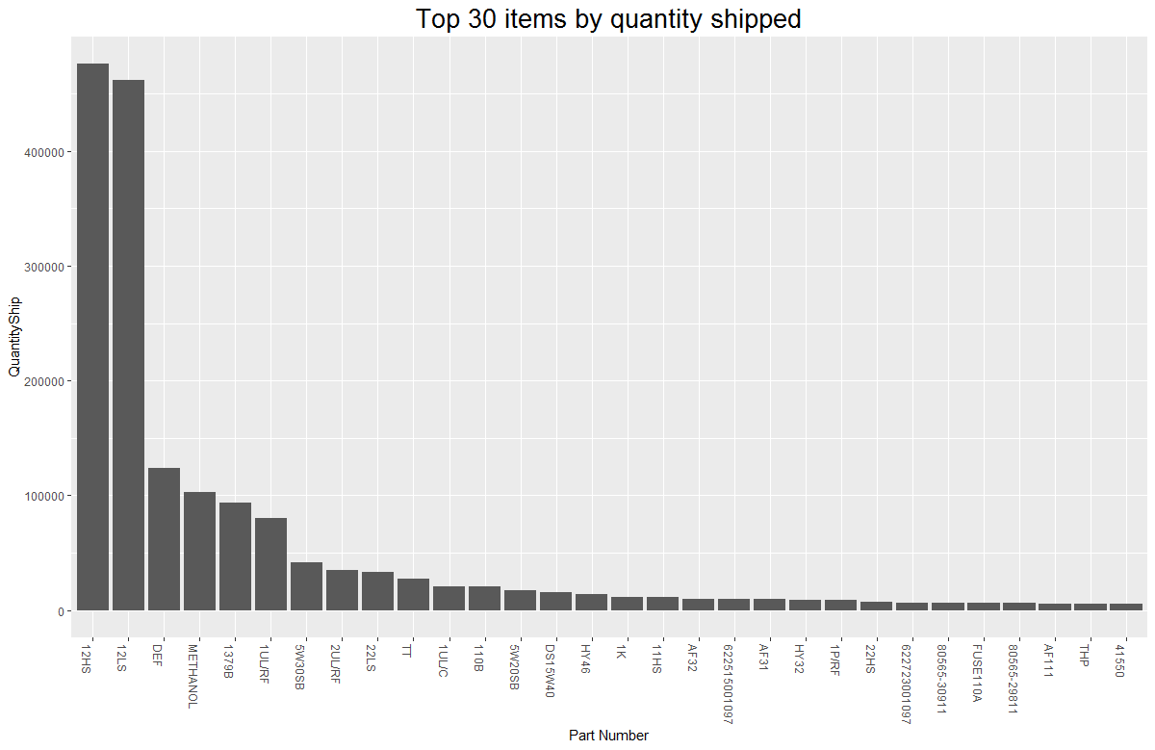
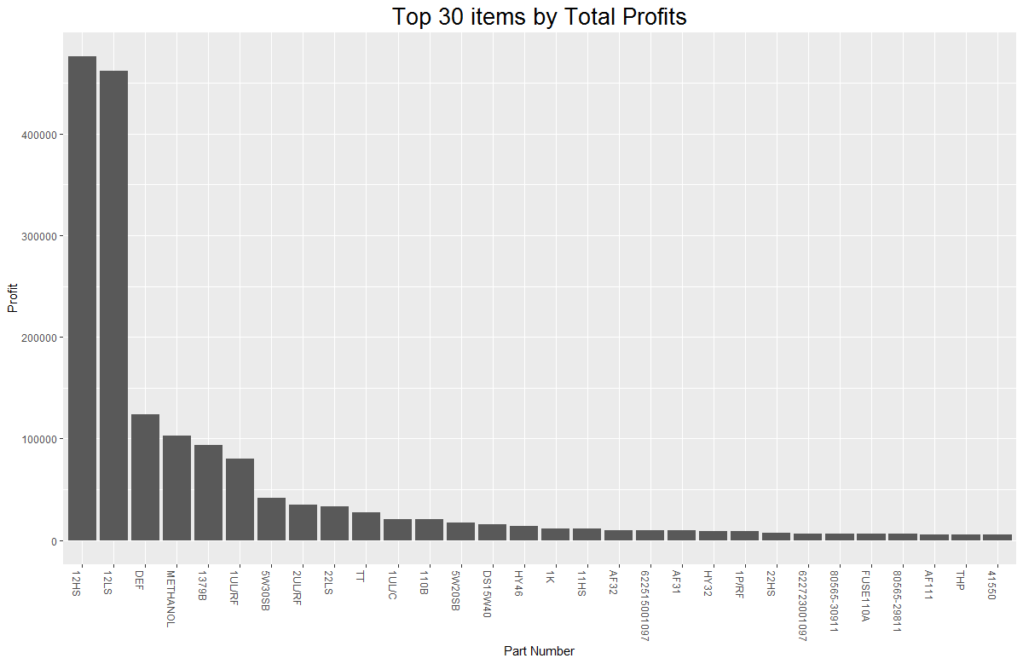
Data Grouping for Bar Plots
12HS and 12LS highest cost and most frequently shipped
Multiple high sales
Most profitable still 12HS and 12LS
GG

Slide 7
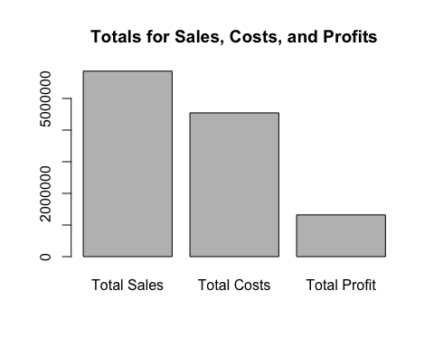
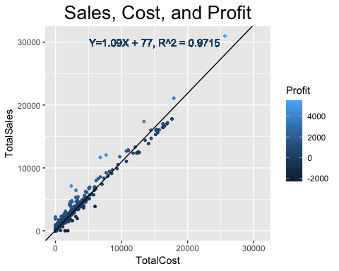
Totals Bar Plot, Linear Regression Model
Linear regression performed on all dataset using costs and sales
P value was < 2.2^10-16
Statistically significant
Sales – Costs = Profit
GG

Slide 8
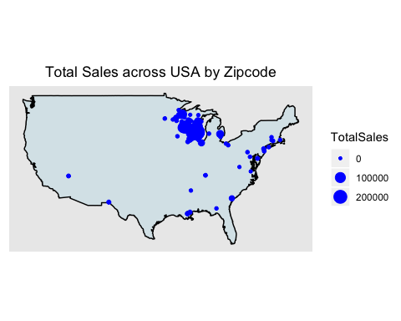
US Map of Total Sales
Company is in Wisconsin
Only 1% of sales were outside of Wisconsin
Zero sales were essentially zero, very low
Data is total by zip codes
GG

Slide 9
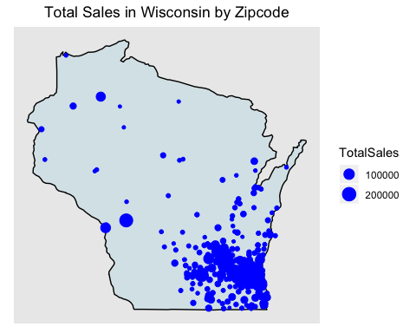
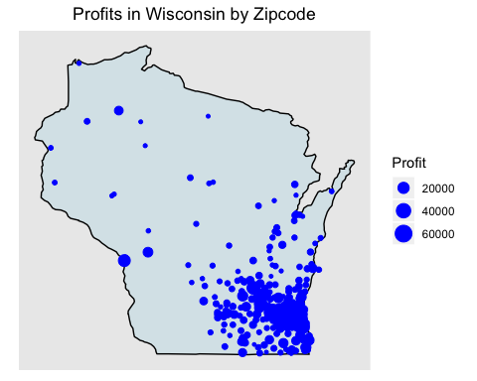
Maps of Sales and Profits in WI
Maps are similar, but most sales are not always more profitable
Most common area for sales is near Milwaukee and Madison
GG

Slide 10
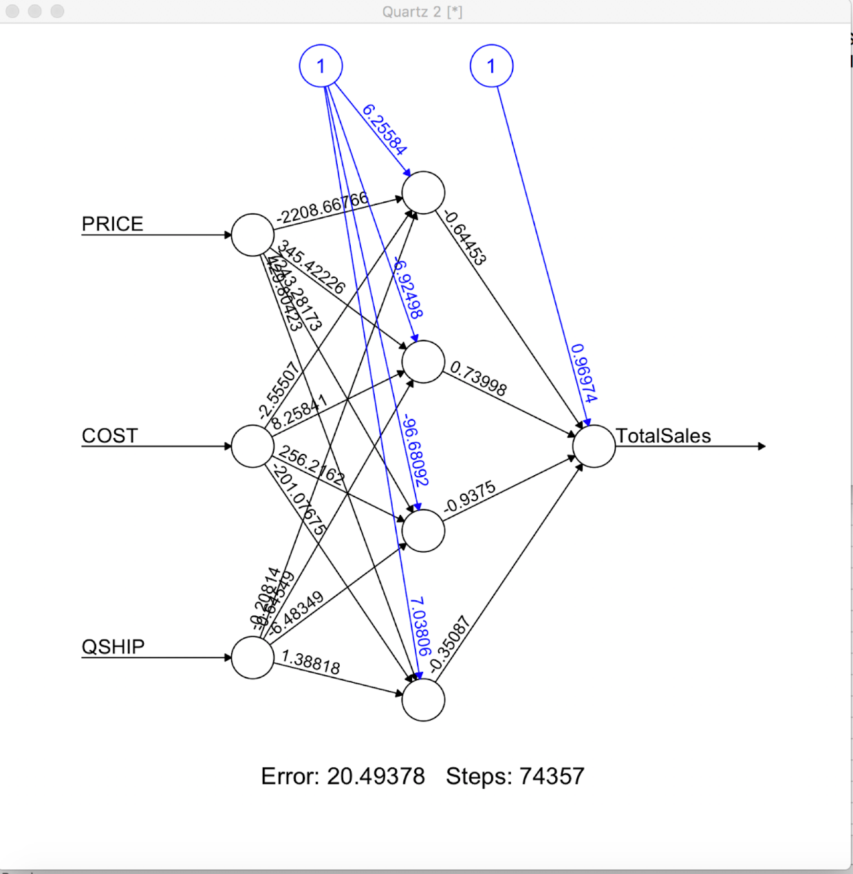
Neural Network Analysis
Neural network analysis was done to predict sales of a product
60% of the dataset was used for training using random sampling
Input layers were price, cost, and qship
BD

Slide 11
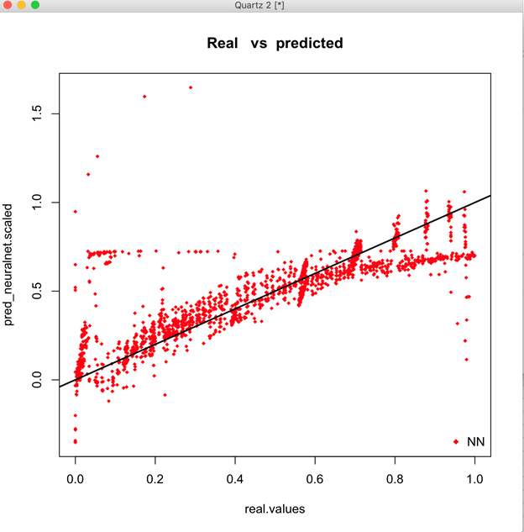
Neural Network Analysis - Model Validation
Neural Network Model Validation using scaled data
The best fitted line shows how close the model matches the real sales vs Predicted sales
The root of the mean squared errors shows how concentrated the data is around the line of best fit.
The root of mean square errors comes in at 0.014
BD

Slide 12
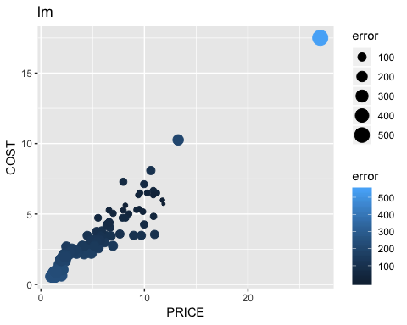
Machine Learning
Associated rules mining
used quantity shipped, price and cost
YYG

Slide 13
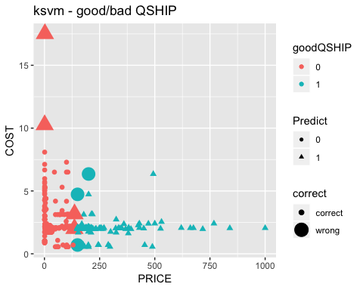
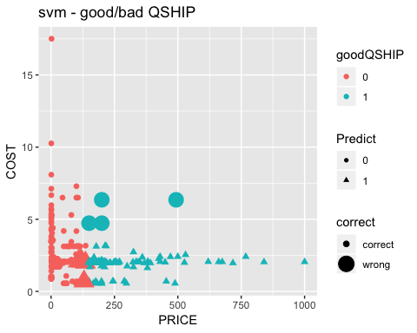
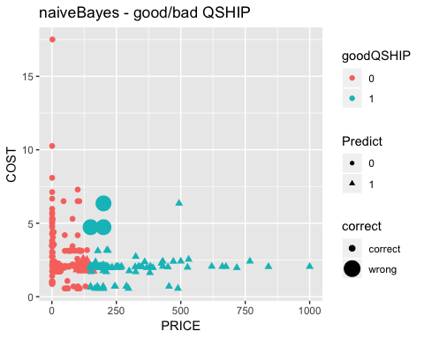
ksvm, svm, naiveBayes QShip
YYG

Slide 14
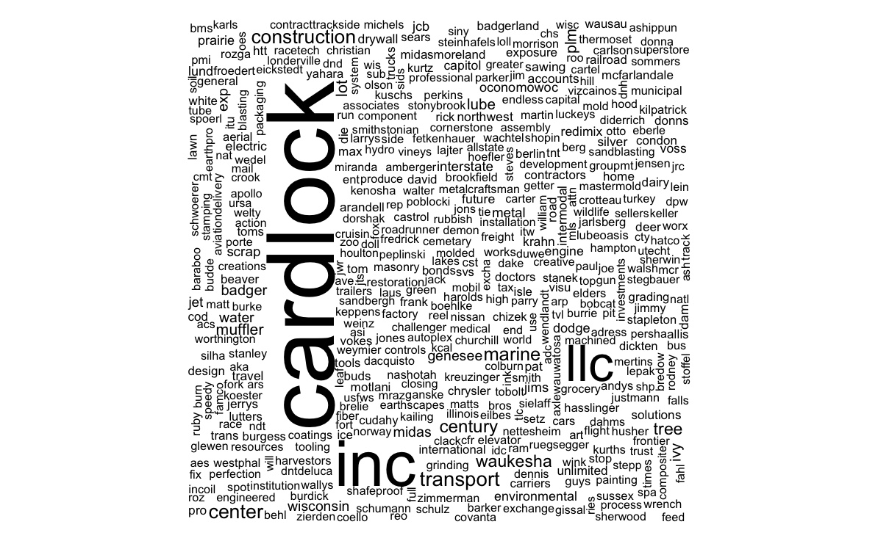
Word Cloud - Most Frequent Customer
Cloud analysis was used to analyze the frequency of keywords.
Target is to find the most frequent customer
STNAME was used , it is the customer delivery address name.
The most common customer was Cardlock
YYG

Slide 15
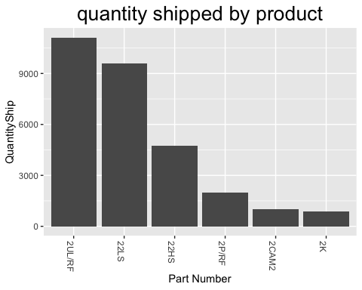
Cardlock
Since the most frequently used Company was Cardlock
Data filtered to include only Cardlock
Data shows the quantity shipped by PNUM to Cardlock
YYG

Slide 16
Conclusion
Top 30 analyses identified
Best selling products by total sales, total quantity shipped, total profits, and product costs.
The products identified are 12HS, 12LS, 5W30SB, 2UL/RF.
Since Corey Oil is a wholesaler, the total profits showed the characteristic of low profit but high quantity overall.
By running the linear regression analysis, we can see the relationship between total costs and total sales.
BD

Slide 17
Conclusion Cont.
The prediction model has helped Corey Oil to confirm the product profit is around 9.3% (2327/25000).
The map plots help the company understand where the majority of sales are located.
Word count analysis helped Corey Oil identified the most frequent transactions occurred mostly at Cardlock gas station.
To sum up, by running different analyses, Corey Oil can understand its strength and extend to more profitable business strategy.
BD

